Slide 1
User Guide to
Accepting New Assets in GSM
GSM function required: Procurement Requestor

Slide 2


These are the steps shown in the following slides for accepting equipment deliveries in GSM
Select the GSM function Procurement Requestor
Select WHO Registrations
Enter the PO number of the asset
Click Go
Click Show
Click of the selected item
Click
Enter the accepted qty
Select the Asset Minor Category
Enter the Warranty Duration
Enter the Barcode Number
Enter the Serial Number (Chassis No. for vehicles)
Choose Accept
Enter the Brand Name
Enter the Model
Enter the Warranty Start Date
Select Custodian Name
Click Save
Notice the confirmation message “Asset Barcode Details are saved”

Slide 3
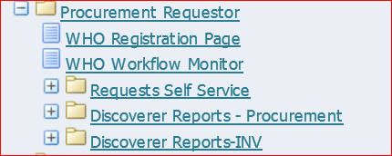
Accepting new equipment in GSM
Select GSM function
Procurement Requestor
then select
WHO Registration Page

Slide 4
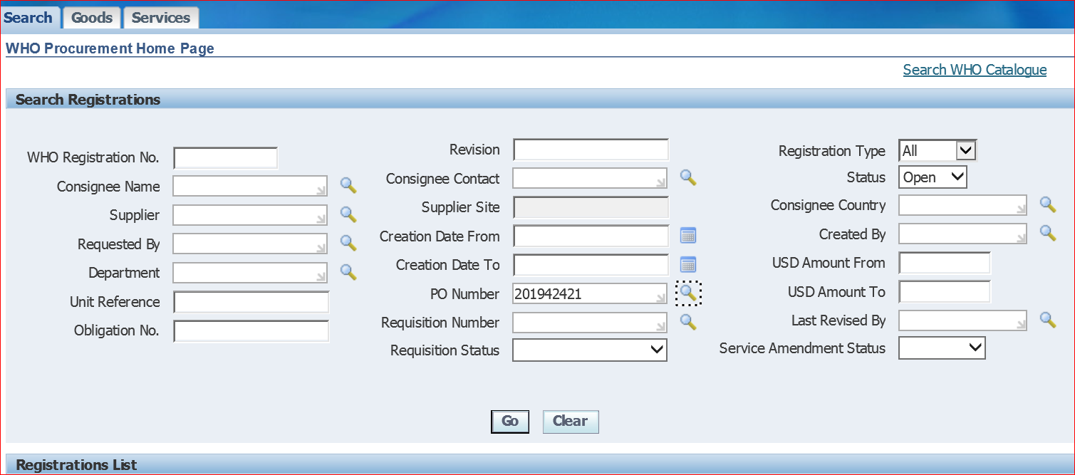
Enter the PO number of the asset and press Go

Slide 5
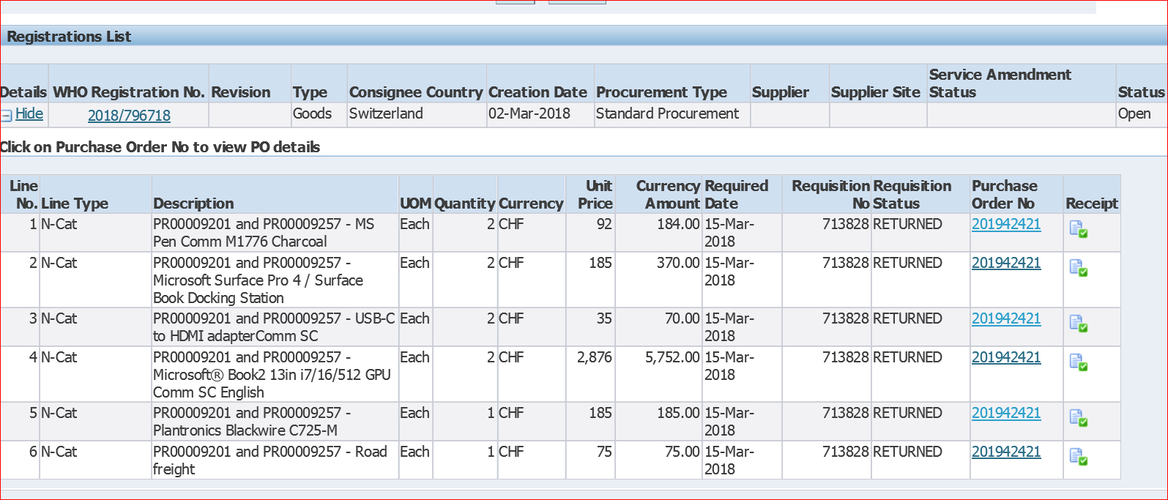
NOTE THAT FROM 2026, ONLY CAPITAL EQUIPMENT IS TO BE RECORDED IN GSM…I.E.ITEMS WITH A UNIT COST OF USD 20,000 OR MORE
Click of the select item

Slide 6
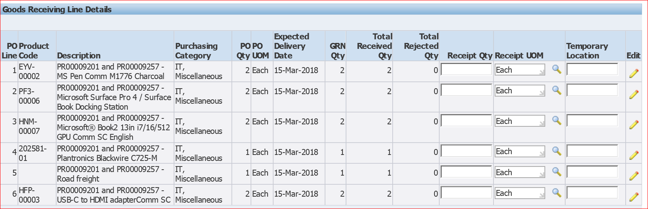

Click

Slide 7
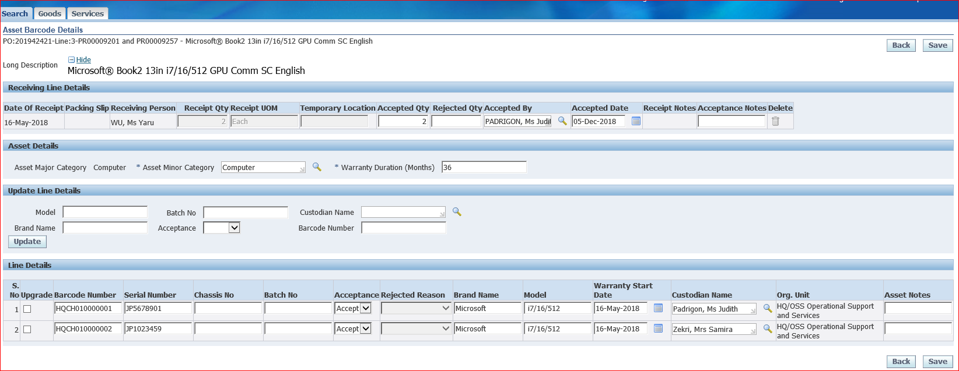
Entering the custodian details:
GSM permits the following choices when recording an item:
The Staff Number (e.g. SO641923) for equipment assigned to a WHO staff member (or SSA holder), or
The Staff Number of the 1st level supervisor for equipment assigned to consultants, interns or UNV’s.
NB: The exact user can be entered in the free text field available after the exact location has been entered in GSM
Enter the accepted qty
Select the Asset Minor Category
Enter the Warranty Duration
Enter the Barcode Number
Enter the Serial Number
Choose Accept
Enter the Brand Name
Enter the Model
Enter the Warranty Start Date
Select Custodian Name
Click Save

Slide 8
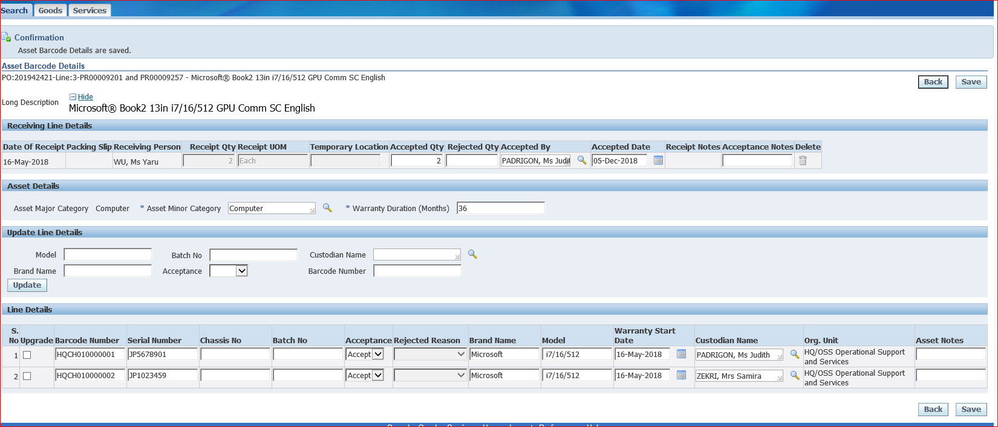
Notice the Confirmation
“Asset Barcode Details are Saved”

Slide 9
QUESTIONS?
For any questions concerning these steps, please contact your Regional Office fixed assets team, or
HQ/AMG at fixedassetshq@who.int

